Slide 1



ANGULAR
CUREMD
AL-MAALIK

Slide 2

TABLE OF CONTENTS
01
02
03
INTRODUCTION
STRING INTERPOLATION
EVENT BINDING
Setup, Pre-req Installations
String Interpolation & Property Binding
Event Binding & Parent/Child Communication
04
05
06
SERVICES & DIRECTIVES
FORMS & ROUTING
HTTP REQUEST
Introduction to Services & Directives
What are Forms & Routing?
Working of HTTP Request

Slide 3


01
INTRODUCTION
What is Angular?

Slide 4





WHAT IS ANGULAR?
Angular is a powerful framework for building dynamic web applications. With its component-based architecture, it allows developers to create reusable and testable code. Let's dive into its features and see how it can transform your web projects

Slide 5
PRE-REQUISITES
01
02
03
HTML, CSS & JS
NODE.JS
ANGULAR CLI

Slide 6

SETUP & INSTALLATION
NODE.JS INSTALL
For installation of Node.JS on your system, just visit their official site and download & install the LTS version.
ANGULAR CLI INSTALL
Open the Terminal and Type the following Command Line:
-- npm install -g @angular/cl
VERIFICATION
Type the Following Command Line to verify the versions of setups:
-- ng version && node version

Slide 7
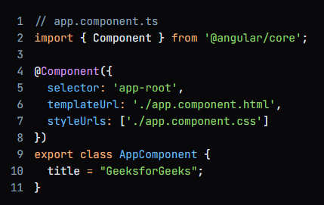
STRING INTERPOLATION
String Interpolation in Angular is a One-way Data-Binding technique that is used to transfer the data from a TypeScript code to an HTML template (view). It uses the template expression in double curly braces to display the data from the component to the view. String interpolation adds the value of a property from the component to the HTML template view.

Slide 8
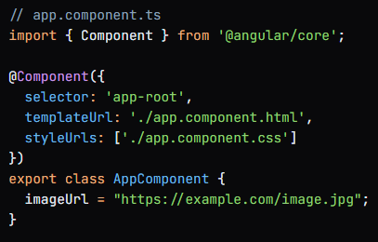
PROPERTY BINDING
Property Binding in Angular is a One-way Data-Binding technique that is used to transfer the data from a TypeScript code to an HTML template (view). It uses the bracket notation ‘[ ]’ to bind the property of an HTML element to a property of a component.

Slide 9
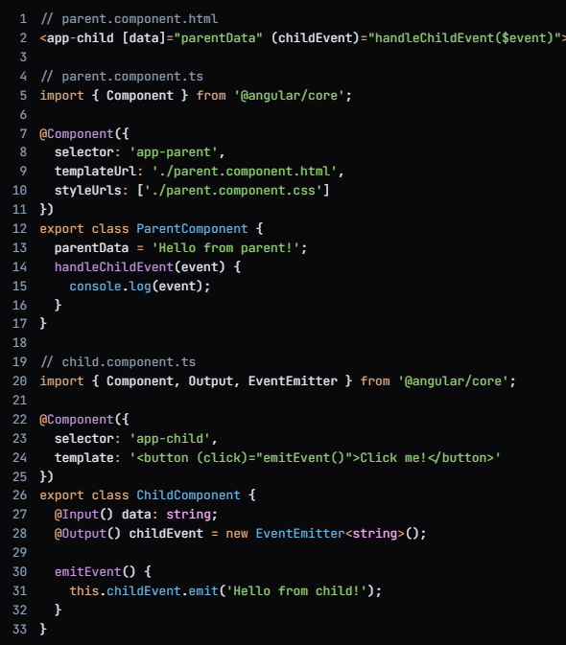
EVENT BINDING
In Angular, Event Binding is a way to bind a DOM event to a component's method. It allows you to respond to user interactions, such as clicks, hover, and keyboard input.
Parent/Child Communication:
In Angular, Parent/Child Communication is a way for components to communicate with each other. It allows you to pass data and events between components.
Methods:
Event Emission: Emit events from child to parent using the @Output decorator.
Service Injection: Share data and functionality between components using services.

Slide 10
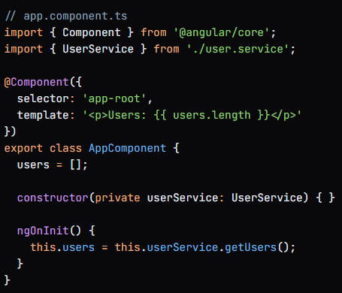
SERVICES
Services in Angular are Singleton objects that provide a way to share data and functionality between components. They are used to encapsulate business logic and provide a layer of abstraction between components and data sources.

Slide 11
KEY CHARACTERISTICS
SINGLETON
Services are instantiated only once, and the same instance is shared across the application.
SERVICES
INJECTABLE
Services can be injected into components using Dependency Injection.
DECOUPLING
Services help decouple components from data sources and business logic.

Slide 12
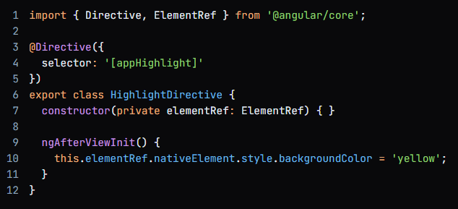
DIRECTIVES
In Angular, a directive is a class that adds new behavior to an element in a template. It's a way to extend the functionality of an HTML element, allowing you to create custom elements, attributes, and components.

Slide 13
TYPES OF DIRECTIVES
COMPONENTS
Directives with a template, used to create custom UI components.
DIRECTIVES
STRUCTURAL
Directives that change the DOM layout, such as ngIf and ngFor.
ATTRIBUTE
Directives that change the appearance or behavior of an element, such as ngClass and ngStyle.

Slide 14
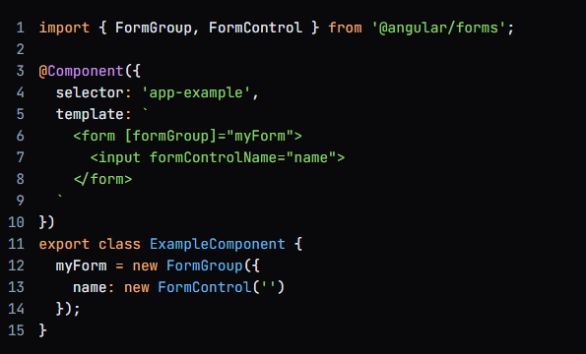
FORMS
In Angular, a form is a way to collect user input, validate it, and submit it to a server. Angular provides a powerful forms API to help you create and manage forms.

Slide 15
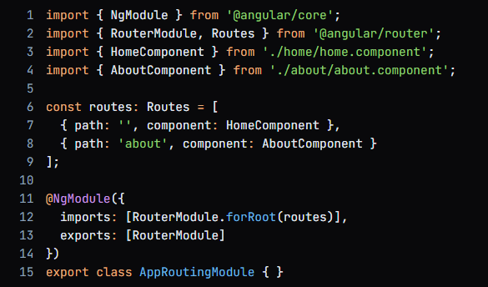
ROUTING
In Angular, routing is a way to navigate between different views or pages in an application. It allows users to interact with the application by changing the URL in the browser's address bar.

Slide 16
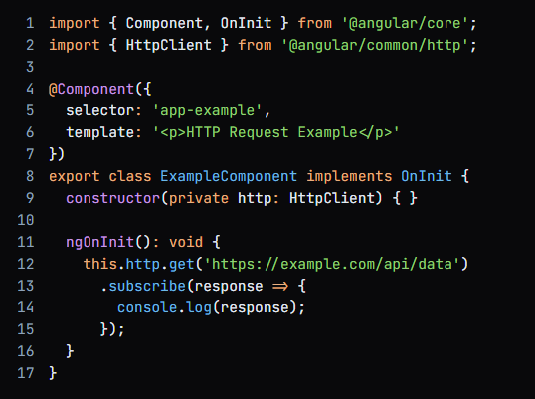
HTTP REQUEST
In Angular, HTTP Request is a way to communicate with a server to retrieve or send data. It allows your application to interact with a backend API, fetch data, and send requests to the server.

Slide 17


THANKS!

